Slide 1



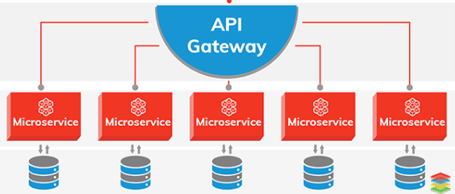

Web Site/App
Collect user event through custom embedded script in website and send to server through http call..
Analytics UX
L O A D B A L A N C E R
Architecture Diagram
1..n
L O A D B A L A N C E R
Micro Service/API GATE WAY for receiving user event
MQ
1..n
Apche KaFka
write stream
Publish Subscribe
Write Raw Data
Read
ETL
Processed data like – what event, time, how, who etc.
Apache Spark
Machine Learning (LR) for data processing/analysis
Parallel message processing
analytics reporting servers
Query Data

Slide 2
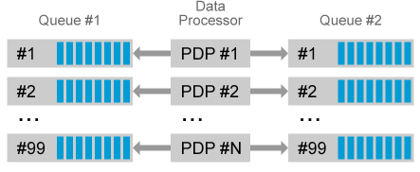
Architecture Explanation
Based on user action/event on website/app micro service will capture and process the data.
Kafka cluster(s) to publish and subscribe the message steam which is fault tolerant and fail safe. It can scale based on the need (Kubernets container orchestration). Due to huge data will be processed queue based technique.
The Raw data will be stored in Cassandra for future processing (in case of historical processing). Cassandra cluster should scale as write events data size increases to huge size
Apache Spark read the data which is further processed by Machine learning technique logistic regression. Hazelcast which is in memory caching technique for computation. Since this is processing server should have good CPU memory.
Through ETL analyzed and processed data stored in Cassandra. ETL process can be configured based on the time.
Micro service based analytics reporting server which is dedicated for query based on the user request for analytics data for reporting.
Finally UI which can be developed in ReactJs for analytics view.

Slide 3
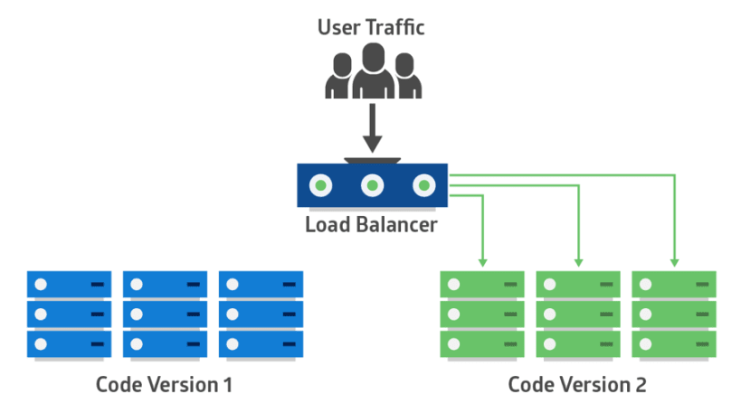

Deployment Strategy
Blue/Green Deployment
In this approach 2 identical application versions work in parallel.
Once the new version of code is available can be deployed green section.
During this time production traffic will be continue in Blue section. Post successful test the traffic can be changed to green part.
This can be achieved by updating application version in yml file in Kubernets and deploy accordingly.

